Slide 1
Visualizing the Generational Economy using
National Transfer Accounts:
Economic Population Pyramids for Austria 2015
Bernhard Binder-Hammer, Lili Vargha
Our research is supported by JPI-MYBL and funded by the Austrian Federal Ministry of Education, Science and Research. JPI-MYBL is supported by J-Age II, which is funded by Horizon 2020, the EU framework programme for research and innovation, under grant agreement 643850.

Slide 2
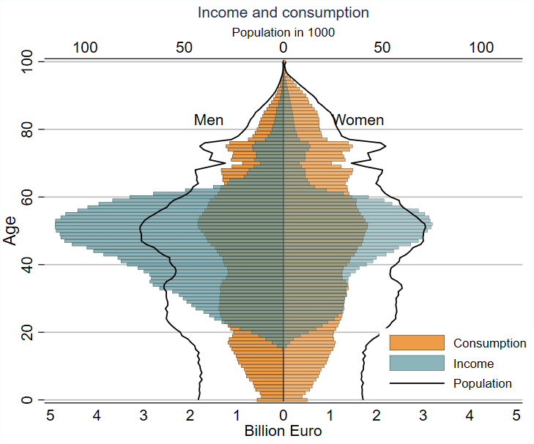
Income and consumption in Austria 2015
Income concentrated at age 20-60
Difference between consumption and income in childhood and old age covered by transfers

Slide 3
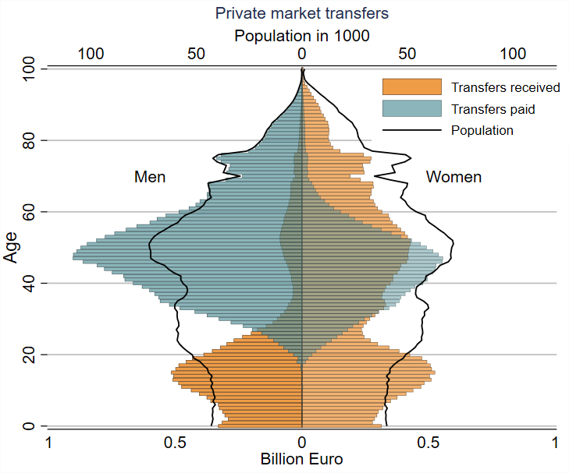
Private market transfers in Austria 2015
2 directions:
From parents to children
From men to women (fathers to mothers)

Slide 4
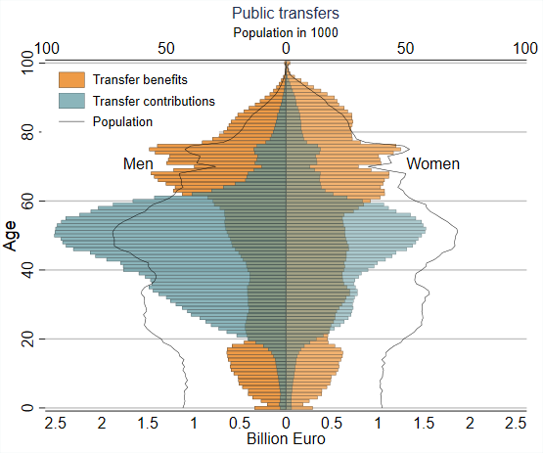
Public transfers
Public transfers: from the working age population to the elderly population
About half of total public transfers received by population aged 60+

Slide 5
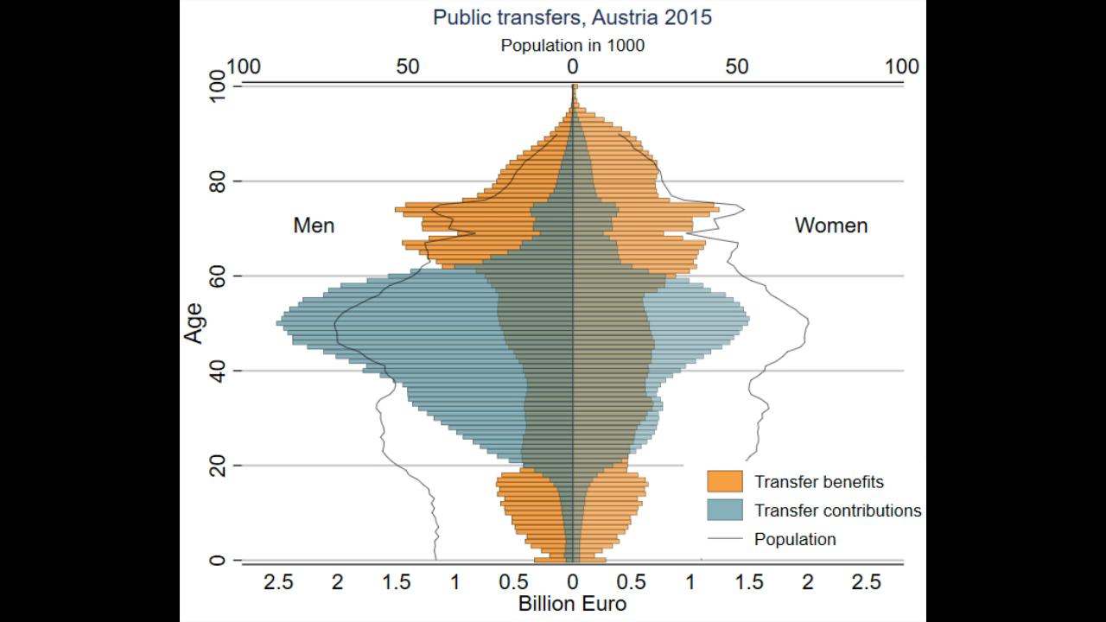
Public transfers

Slide 6
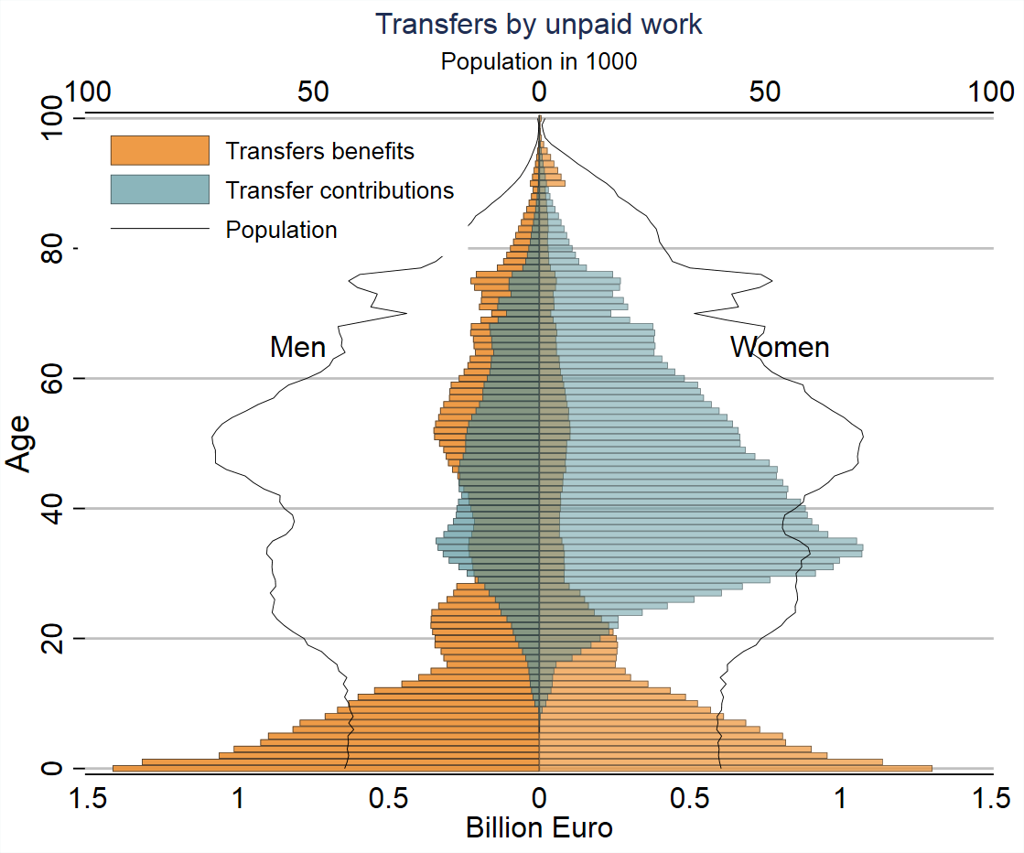
Private non-market transfer
2 directions of non-market transfers
Mothers to children
Women to men (mothers to fathers)

Slide 7
European NTA data
The European National Transfer Accounts data-explorer contains a tool to generate NTA-based economic population pyramides:
www.wittgensteincentre.org/ntadata

